Slide 1


Geometric Analysis Based Algorithms for Effective Representation and Detection of Curves with Application to Tracking Moving Dim Target
Advisor: Dr. Ofer Levi
By: Galit Volpert

Slide 2
Presentation Outline
Motivation
Objectives
Background
Design
Results

Slide 3
Motivation
Geometric Analysis
Detect, organize, represent, and manipulate
data which nominally span a high-dimensional space but which contain important features which are approximately concentrated on lower-dimensional subsets (curves, sheets, etc.).
http://www.ipam.ucla.edu/programs/long-programs/multiscale-geometry-and-analysis-in-high-dimensions/
Notes:
Scientific area that deals with…..

Slide 4
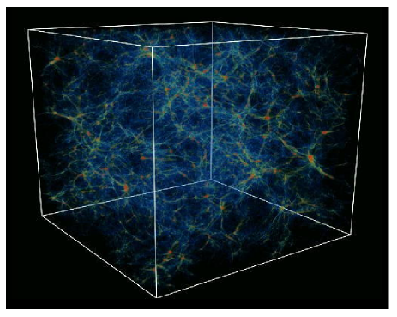
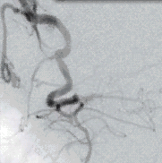
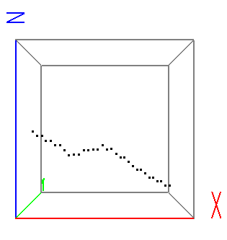
Motivation
Data of Interest
n³ – voxels (cube), f(x,y,z)
-point field
Contains filaments and noise
Notes:
Features in 3D

Slide 5
Motivation
Applications
Medical and Biological Imaging
Astronomy
Dim Objects Detection and Tracking

Slide 6
Objective
Validate the SHAS a Geometric approach algorithm accuracy and efficiency by comparing to other discrete X-Ray transform algorithms such as Fast Slant Stack and Two-Scale Recursion.
Present the Dynamic SHAS as a computationally efficient algorithm for dynamically computing X-Ray coefficients inside a sliding window.
Develop a Dynamic SHAS based tool for tracking a dim maneuvering target.

Slide 7
Background
The 2D X-Ray (Radon) Transform
As
Notes:
Scientific area that deals with…..

Slide 8
Background
The 3D X-Ray Transform
As
Notes:
Scientific area that deals with…..

Slide 9
Background
Bcvbcbv
Bcvbcv
Bcvbcb
Bcvcbvc
cbvbcb

